Slide 1

1D Rydberg atom arrays: An entry point to studying isolated quantum many body systems out of equilibrium
Name: Oliver Lind
Supervisor: Prof Stuart Adams
Notes:
I am going to give talk 1D Rydberg atom arrays
And how these systems are a really interesting entry point to studying isolated quantum systems

Slide 2
Quick Aside
Two ideas for this talk
1D Rydberg atom arrays quantum simulators
Entanglement entropy dynamics of system
Entry point
Behind
Understanding characteristics of isolated quantum systems
Studying isolated quantum systems out of equilibrium dynamics
Characteristics of isolated quantum systems out of equilibrium
Notes:
I really struggled to make this presentation
Two things I really wanted to talk about
The first one is…
Second one is…
But with 20 mins on the clock would be too ambtious
Two competing ideas
Stick with this as my ideas are a bit more coherent
But I want to acknowledge this..
- This graph is not going to make much sense but this was the starting point of the project
-motivated by the paper below
-What it shows is ordered behavior arising from a quantum system push out far from equilibrium
- What we would learn is that is what underlies it is very deep. We were scratching the tip of the iceberg.

Slide 3
Motivation
Classical Isolated System
Adiabatic walls (no transfer of heat outwards)
Balloon with ideal gas inside
Rest of the chamber is a vacuum
Vacuum
Notes:
We have used the word out of equilibrium a lot
Let’s look at what happen in we initial start out of equilibrium in an classical isolated system
Adiabatic walls so isolate
Balloon with an ideal gas inside
Peirce the balloon

Slide 4
Motivation
Classical Isolated System
Adiabatic walls (no transfer of heat outwards)
Balloon with ideal gas inside
Rest of the chamber is a vacuum
Peirce the balloon
Out of equilibrium initial state
Notes:
Peirce the balloon
Out of equilibrium state

Slide 5
Motivation
Classical Isolated System
Adiabatic walls (no transfer of heat outwards)
Balloon with ideal gas inside
Rest of the chamber is a vacuum
Peirce the balloon
Air particles spread
Out of equilibrium state
Notes:
Evntually if we

Slide 6
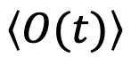
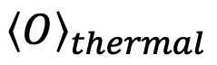
Motivation
Classical Isolated System
Adiabatic walls (no transfer of heat outwards)
Balloon has N particles with total energy E
Rest of the chamber is a vacuum
Peirce the balloon
Air particles spread
System thermalizes
Macroscopic observables reach steady average value:
$$\left\langle O(t)\right\rangle$$
$${\left\langle O\right\rangle }_{thermal}$$
Reaches Equilibrium

Slide 7
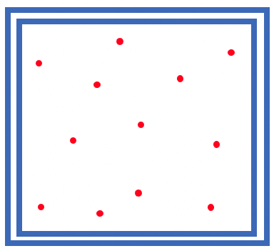
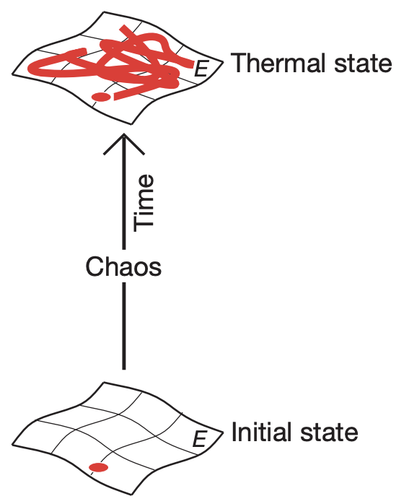


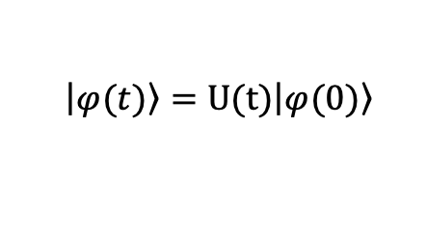

Motivation
Statistical Physics
What happens in an isolated quantum system?
Unitary time evolution
Maximum Entropy
$$\left|\left.φ(t)\right\rangle \right.=U(t)\left|\left.φ(0)\right\rangle \right.$$
Can the system thermalize in the same way?
Can we associate entropy in the same way?
Are there global properties that can help us understand this?
Low Entropy
Rigol, et al. Nature 452, 854–858 (2008)
Notes:
Statiscal physics tells us this system explores every possible configuration in phase as a result of dynamical choas
Initial conditions of the system don’t matter and eventually get lost
Entropy is maximised as the system thermalise
What happens in an isolated quantum system
Unitary time evolution is linear, reversible initial state is encoded throughout
If we know the initial state we know the state at any time
So in a way it is not forgotten

Slide 8
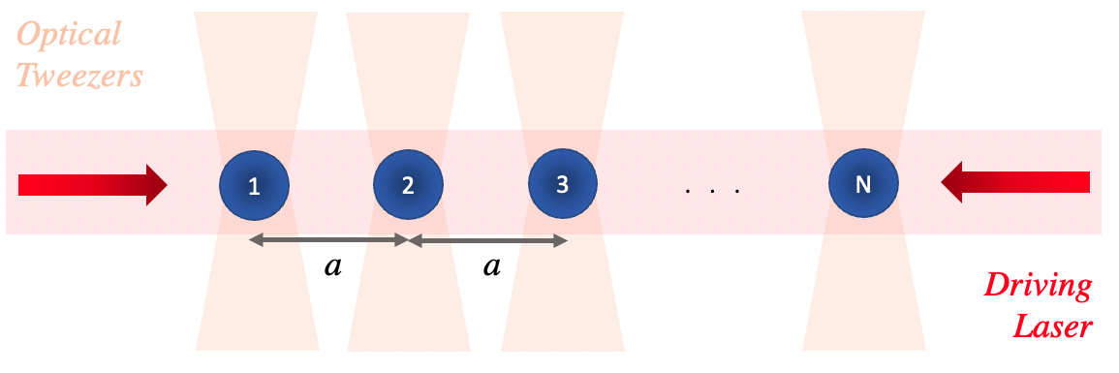
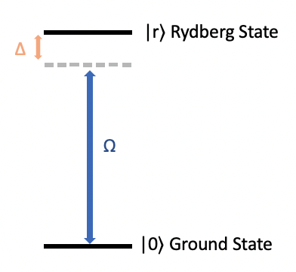
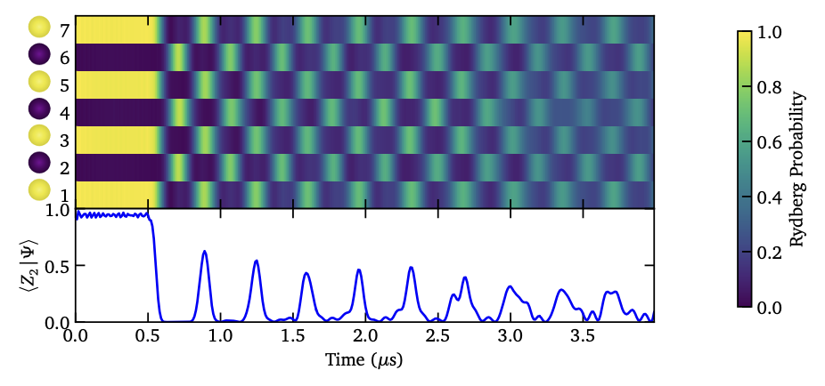
Contents
1.
Introduce the model
Rydberg Atoms
Rydberg Blockade
Ising Type Hamiltonian
Generating order phases
Bringing the system out of equilibrium
Why is it a good entry point?
2.
3.
Running numerical simulations of quantum simulation protocols done on ultra cold neutral atoms

Slide 9
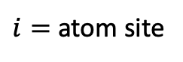
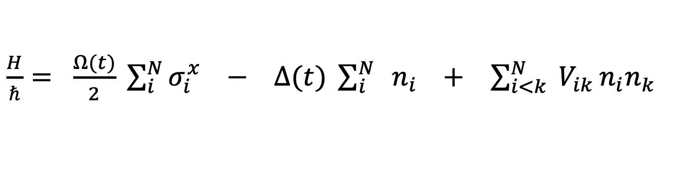
Set up
$\frac{H}{ℏ}= \frac{Ω(t)}{2} \sum_{i}^{N}{σ_{i}^{x}} −$ $∆(t) \sum_{i}^{N}{ { n}_{i}}$ $+$ $\sum_{i<k}^{N}{ V_{ik}}n_{i}n_{k}$
$i=$ atom site
Driving term
Detuning term
Interaction term
Notes:
Atoms with an electron in a highly excited state
Delocalized and far away from the atom appear hydrogen like
Large dipole moment amongst a lot of other interesting properties

Slide 10
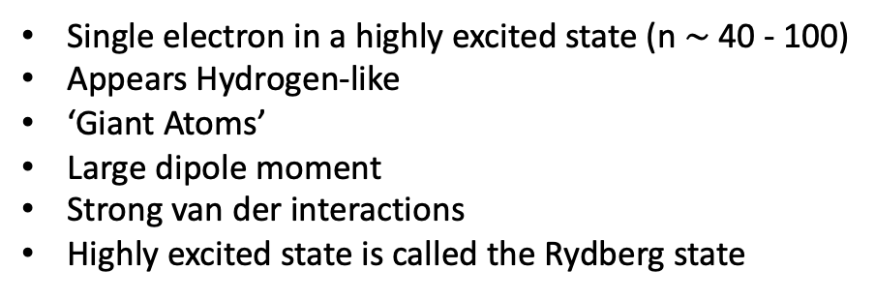
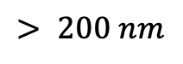
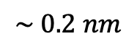
Rydberg Atoms: What are they?
Single electron in a highly excited state (n $\sim$40 - 100)
Appears Hydrogen-like
‘Giant Atoms’
Large dipole moment
Strong van der interactions
Highly excited state is called the Rydberg state
+
Size
$$\sim 0.2 nm$$
$$> 200 nm$$
Notes:
Atoms with an electron in a highly excited state
Delocalized and far away from the atom appear hydrogen like
Large dipole moment amongst a lot of other interesting properties

Slide 11
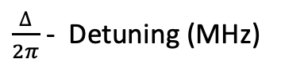
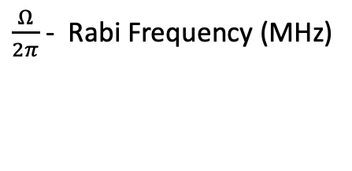
Rydberg Atoms: Encoding as qubit
Use a laser to couple Ground and Rydberg states of atom
Two level system forms our qubit
Driving Laser
$\frac{Ω}{2π}$ - Rabi Frequency (MHz)
Strength of coupling between states
$\frac{∆}{2π}$ - Detuning (MHz)
How far of resonance driving laser is
Notes:
Laser to couple Ground and Rydberg states
Two level system form our quibit
Strength of coupling between states and is associated with the amplitude to the laser

Slide 12
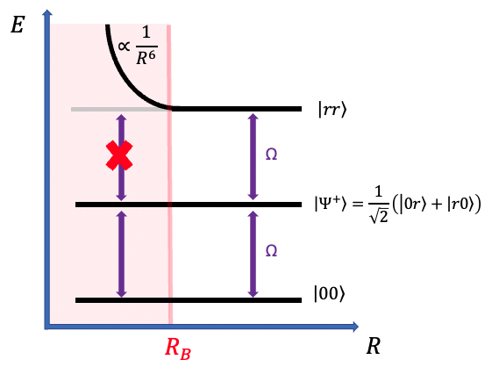
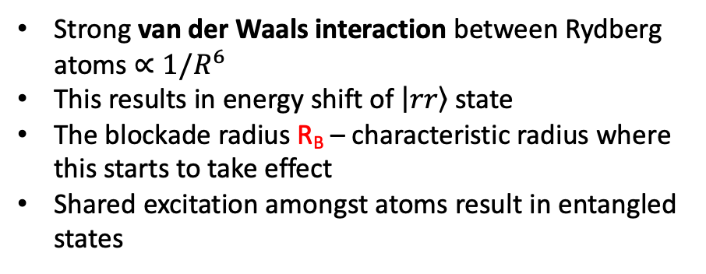
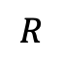
Interaction and Rydberg Blockade
Two atoms
$$R$$
Strong van der Waals interaction between Rydberg atoms $∝1/R^{6}$
This results in energy shift of $\left|\left.rr\right\rangle \right.$ state
The blockade radius R_{B} – characteristic radius where this starts to take effect
Shared excitation amongst atoms result in entangled states
Notes:
Now lets introduce interaction
Consider two atoms separated by a distance R
Strong van der waals interaction between Rydberg atoms
This results in an energy shift of doubly excited state
So if to atoms are close together can’t drive to the rr state

Slide 13
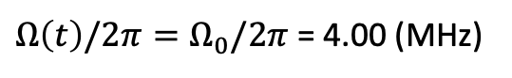
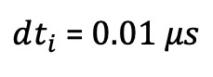
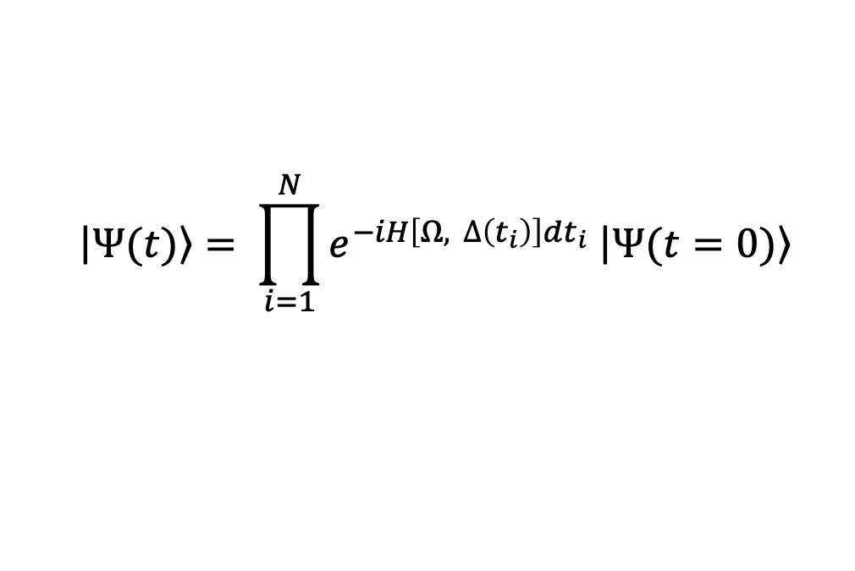
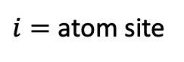
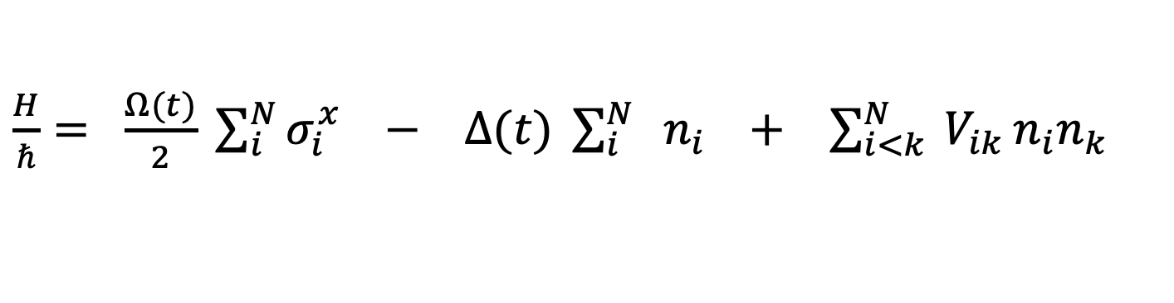
Many Body Hamiltonian
Evolve the system with Trotter-Suzuki decomposition:
$$\left|\left.Ψ(t)\right\rangle \right.= \prod_{i=1}^{N}{e^{−iH\left[Ω, ∆\left(t_{i}\right)\right]dt_{i}} \left|\left.Ψ(t=0)\right\rangle \right.}$$
$dt_{i}$ =$0.01 μs$
$\frac{H}{ℏ}= \frac{Ω(t)}{2} \sum_{i}^{N}{σ_{i}^{x}} −$ $∆(t) \sum_{i}^{N}{ { n}_{i}}$ $+$ $\sum_{i<k}^{N}{ V_{ik}}n_{i}n_{k}$
$i=$ atom site
Driving term
Detuning term
Interaction term
$Ω\left(t\right)/2π=Ω_{0}/2π$ = 4.00 (MHz)
Bernien, et al Nature 551, 579-584 (2017)
Notes:
Put all these component into a Hamiltonian
First set up
Consider an array of N atoms equidistant from each other in a chain
Hamiltonian in three parts
First term coupling between ground and Rydberg states for each atom due to driving laser
Second tells how far of resonance laser is
Third is responsible for the interaction of Rydberg states
(Not doing justice to the inrceble experimental techjniques that trap atoms)
To numercally solve the schrodinger equation we will evolve of system with trotter sucuki decomposition
Taking dtt = 0.01 microseconds
And our Rabi frequency we will set constant to 4 (MHz)

Slide 14
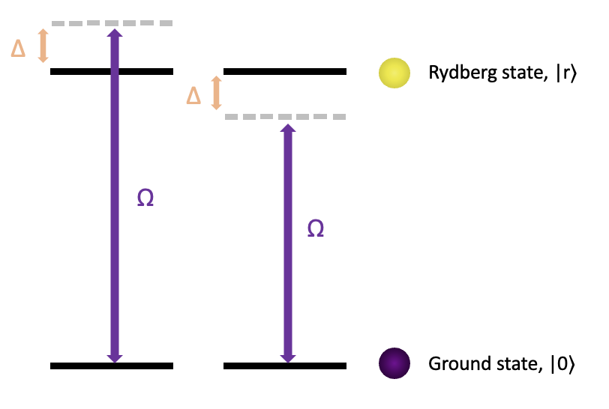
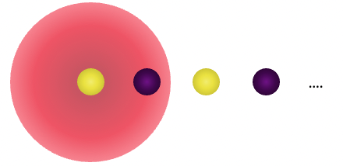
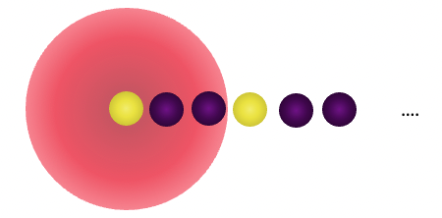
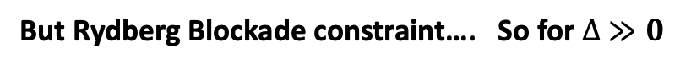
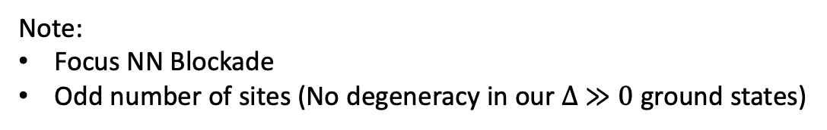
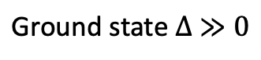
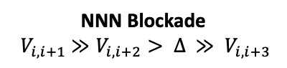
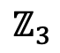
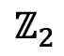
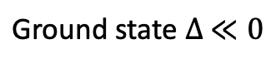
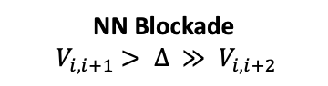
Using blockade to generate ordered states
$$\text{Ground} \text{state} ∆ ≪0$$
$$\text{Ground} \text{state} ∆ ≫0$$
But Rydberg Blockade constraint…. So for $∆ ≫0$
$$ℤ_{2}$$
$$ℤ_{3}$$
NN Blockade
$${ V}_{i, i+1} > ∆ ≫ V_{i, i+2}$$
NNN Blockade
$${ V}_{i, i+1} ≫V_{i, i+2}> ∆ ≫ V_{i, i+3}$$
Note:
Focus NN Blockade
Odd number of sites (No degeneracy in our $∆ ≫0$ ground states)
Notes:
Positive detuning is upwards
Laser is below resonance all in the ground state
Laser is above resonance all in the excited state
But Rydberg B constaint
So subject to this constraint we get ordered stated
NN the Z2
Odd number of sites
No degeneracy in high detuning ground states
Due to symmetry

Slide 15
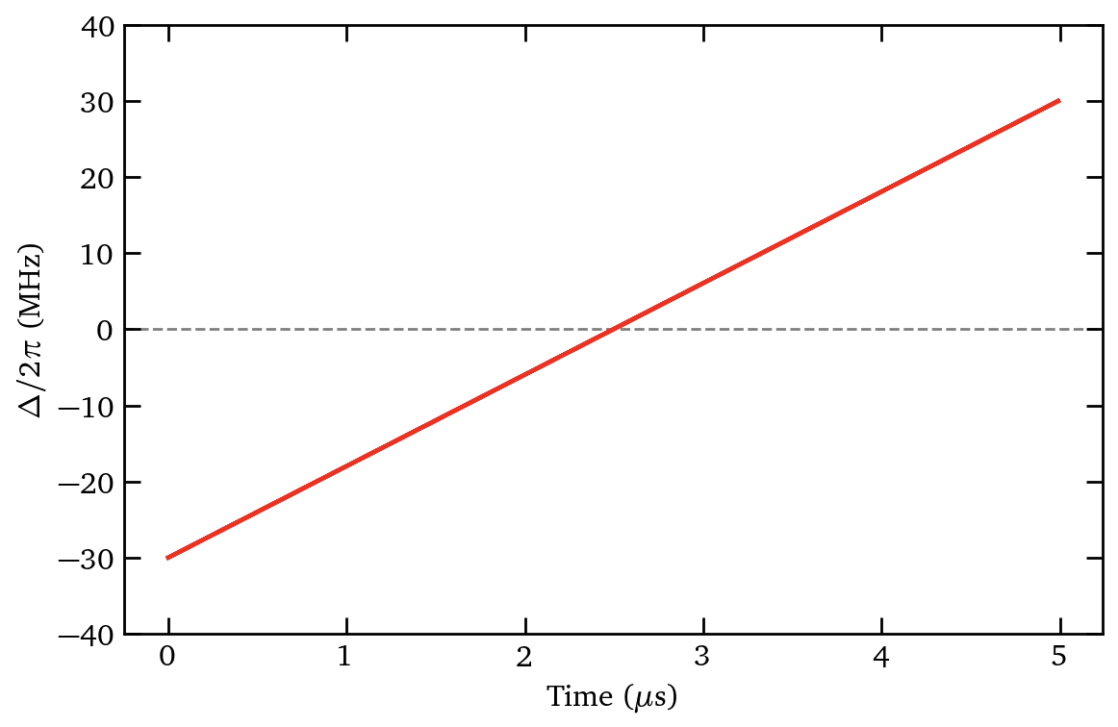
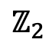

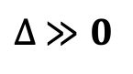

Using blockade to generate ordered states
Focus on 7 atom
Evolve the system adiabatically
$$\text{Ground} \text{state} ∆ ≪0$$
$$\text{Ground} \text{state} ∆ ≫0$$
By adjusting the separation between atoms $a$, we can sweep through detuning values to generate desired ordered states:
But Rydberg Blockade constraint…. So for $∆ ≫0$
Focus on 7 Atoms
$∆ ≫0$ Ground State
$$ℤ_{2}$$
NN Blockade
$${ V}_{i, i+1} > ∆ ≫ V_{i, i+2}$$
NNN Blockade
$${ V}_{i, i+1} ≫V_{i, i+2}> ∆ ≫ V_{i, i+3}$$
$∆ ≪0$Ground state
Note:
Focus NN Blockade
Odd number of sites (No degeneracy in the ground state)
$∆ ≫0$
Odd GS
Even GS
Notes:
Annealing regime
Evolve the system adiabatically by sweeping through detuning values
If we go slow enough we stay in the systems ground state
And can end up in ordered

Slide 16
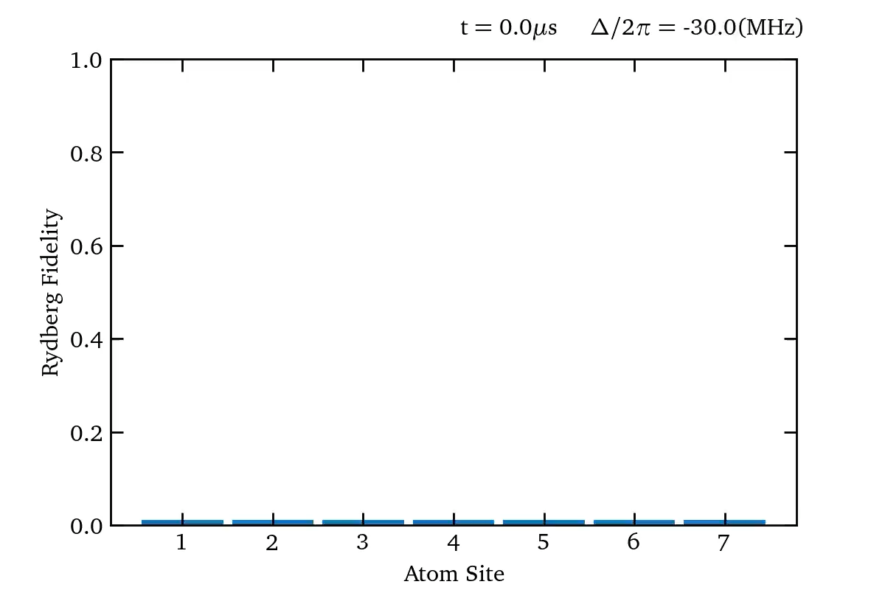
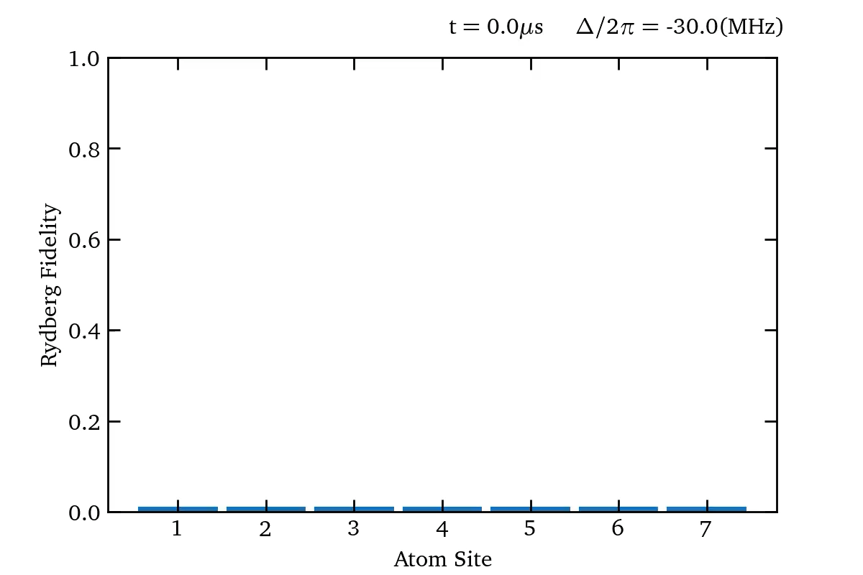
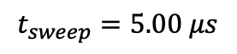
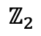
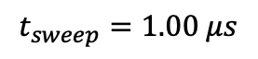
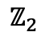
Using blockade to generate ordered states
$$t_{sweep}=5.00 μs$$
$$t_{sweep}=1.00 μs$$
$$ℤ_{2}$$
$$ℤ_{2}$$
Notes:
Simulation for of this for two different times
We can see for the faster sweep Z2 is lees apparent
Measure probability of each atom in excited state
Went too faster so no longer adiabatic

Slide 17
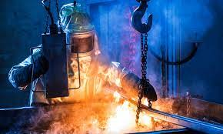
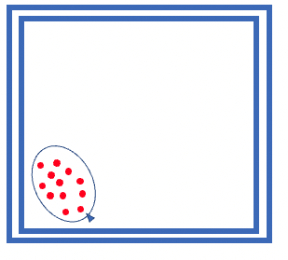

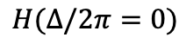
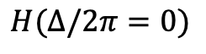
What if we intend on going quickly: quenches
$$ℤ_{2}$$
$$H(∆/2π=0)$$
$$H(∆/2π=0)$$
How we take the system out of equilibrium
Analogues to balloon popping
Notes:
What if we intend to go quick and break adaiabaticy
Analogous to a metal work hot metal cold wate
What sort of behaviour do we expect

Slide 18
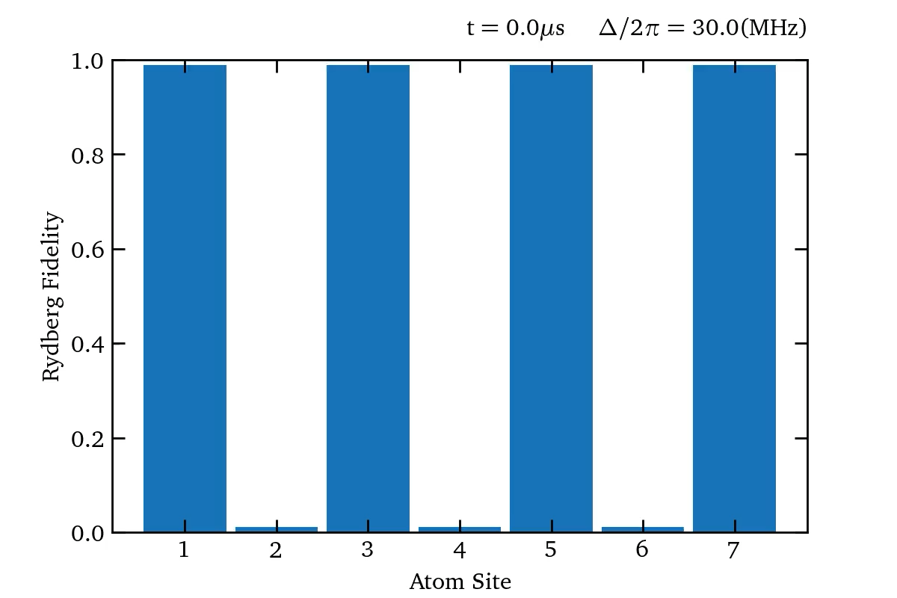
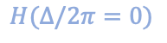
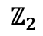
Taking the system out of equilibrium
$$ℤ_{2}$$
$$H(∆/2π=0)$$
Notes:
We can run the same simulation this time starting from the z2 ordered state
Nice order oscillations and revivals of initial z2
As before look at eigenenergies
This time of quenched system

Slide 19
So why is this a good entry point?
Interesting novel behavior
Quantum many body scars
Tunability and versality to try different things
Local quenches
Slower quenches
Different initial configurations
What lies underneath
Entanglement
Propagation of information
Notes:
Isolated quantum system can thermalize due to the eigenstate thermalization hypothesis (ETH)
Observables of subsystems can mimic thermal equilibrium because the system explores a superposition of many eigenstates effectively acting as it’s on heat bath
Something done on an internal level due to many degrees of freedom

Slide 20

So why is this a good entry point?
1. Interesting novel behavior
Revival of the initial state after the quench is a behavior know as quantum many body scars
Type of behavior know as weak ergodicity breaking
$$\left|\left.φ(t)\right\rangle \right.=\sum_{n}{a_{n}e^{−iE_{n}t}}\left|\left.n\right\rangle \right.$$
Quantum Chaotic System
(‘thermalizes’)
Many Body Localization
(does not ‘thermalize’)
Quantum many body scars
Serbyn, Maksym, et al. Nature Physics 14, 745-749 (2018)
Notes:
Isolated quantum system can thermalize due to the eigenstate thermalization hypothesis (ETH)
Observables of subsystems can mimic thermal equilibrium because the system explores a superposition of many eigenstates effectively acting as it’s on heat bath
Something done on an internal level due to many degrees of freedom

Slide 21

So why is this a good entry point?
2. Tunability and versatility to try different things
Vary the speed to the quench
Local addressing and quenches
Evaluate different out of equilibrium regimes
Quench different initial states
Investigate which states have scar behavior
Propagation of information
Formations of correlations
Notes:
Local addressing and local quench
Only quench atom 1
This has opened up avenues to exploring concepts such a speed of information traveling through the system

Slide 22


So why is this a good entry point?
What lies underneath
Graphs don’t give the whole picture
Correlations between atoms
Entanglement
Looking at entanglement growth and scaling with the system

Slide 23
Acknowledgements
Supervisor: Prof Stuart Adams
PHD Student: Toonyawat Angkhanawin

Slide 24











Values
$\frac{H}{ℏ}= \frac{Ω}{2} \sum_{i}^{N}{σ_{i}^{x}} −$ $∆ \sum_{i}^{N}{ { n}_{i}}$ $+$ $\sum_{i<k}^{N}{ V_{ik}}n_{i}n_{k}$
$i=$ atom site
Driving term
Detuning term
Interaction term
$$V_{ik }=\frac{C_{6}}{r^{6}}$$
$σ_{i}^{x}=\left|\left.0_{i}\right\rangle \right.\left\langle \left.r_{i}\right|+ \right.$ $\left|\left.r_{i}\right\rangle \right.\left\langle \left.0_{i}\right|\right.$
$$n_{i}=\left|\left.r_{i}\right\rangle \right.\left\langle \left.r_{i}\right|\right.$$
$Ω/2π=$ 4.00 (MHz)
$$r=a\left|i−k\right|$$
Rb Atoms: $C_{6}\text{/} 2π$= 863000 MHz $μm^{6}$
Evolve the system with Trotter-Suzuki decomposition:
$$\left|\left.Ψ(t)\right\rangle \right.= \prod_{i=1}^{N}{e^{−iH\left[Ω, ∆\left(t_{i}\right)\right]dt_{i}} \left|\left.Ψ(t=0)\right\rangle \right.}$$
$dt_{i}$ = $t_{i}−t_{i−1}$
$dt_{i}$ =$0.01 μs$
Bernien, et al Nature 551.7682 (2017)

Slide 25
Thermalization or lack there of

Slide 26




Entanglement: can this offer us any further insight?
Two qubits
Product states
$$\frac{1}{\sqrt{2}}\left(\left|\left.0\right\rangle +\left|\left.r\right\rangle \right.\right.\right)⊗ \frac{1}{\sqrt{2}}\left(\left|\left.0\right\rangle +\left|\left.r\right\rangle \right.\right.\right)$$
Atom 1
Atom 2
Entangled states
$$\left|\left.Ψ^{+}\right\rangle \right.=\frac{1}{\sqrt{2}}\left(\left|\left.0r\right\rangle +\left|\left.r0\right\rangle \right.\right.\right)$$
Need Atom 2 to fully describe the state of atom 1

Slide 27







Entanglement Entropy
$$\left|\left.φ\right\rangle \right.$$
Density Matrix
$$ρ=\left|\left.φ\right\rangle \right.\left\langle \left.φ\right|\right.$$
$\left|\left.φ\right\rangle = \right.$ ${\left|\left.φ\right\rangle \right.}_{A}$ $⊗{\left|\left.φ\right\rangle \right.}_{B}$
$\left|\left.φ\right\rangle ≠ \right.$ ${\left|\left.φ\right\rangle \right.}_{A}$ $⊗{\left|\left.φ\right\rangle \right.}_{B}$
A
B
Reduced Density Matrix
$$ρ_{A}={Tr}_{B}(ρ)$$
Everything we can know about A without B
$$n_{i}=\left|\left.r_{i}\right\rangle \right.\left\langle \left.r_{i}\right|\right.$$
Von Neuman Entropy Between A and B
How uncertain is the information in $ρ_{A}$

